Slide 1
Storage Systems
Introduction to Energy Storage Systems (ESS) ESS are essential for integrating renewable energy, ensuring grid stability, and improving efficiency.
Types of storage: Mechanical, Electrochemical, Thermal, Chemical. Applications: Renewable integration, load shifting, backup power

Slide 2
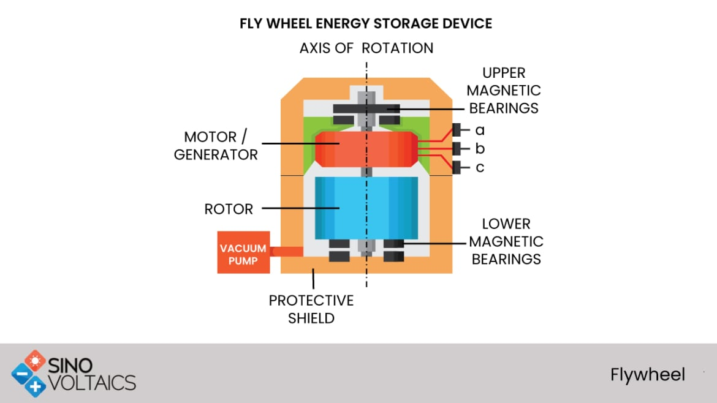
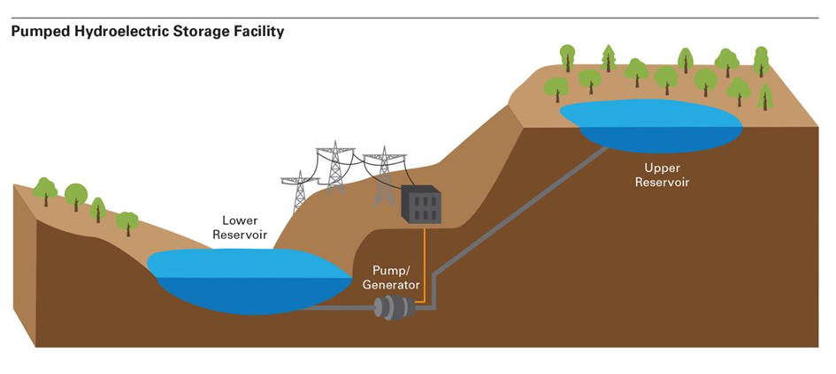
Mechanical Storage
Flywheel Energy Storage (FES): A mechanical energy storage system that stores kinetic energy using a rotating mass, or flywheel and has seen growing popularity in renewable energy applications.
Pumped Hydroelectric Storage (PHS):storing energy by pumping water to a higher reservoir and generating electricity by releasing it through turbines during high demand.

Slide 3
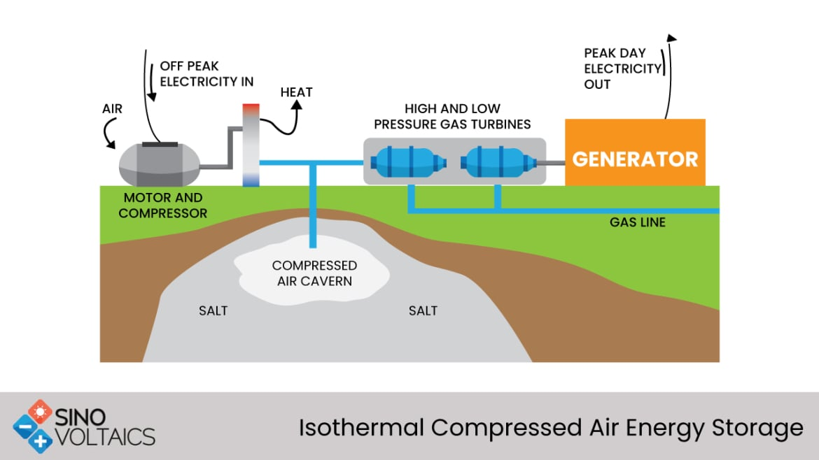
Mechanical Storage
Compressed Air Energy Storage (CAES): A technology that stores energy by compressing air in underground caverns or tanks during low demand times and releasing it to generate electricity during peak demand.

Slide 4
Pros and Cons.
Low energy capacity (PHS/CAES) High initial cost Not suitable for long term storage | + High efficiency | FES
Geographic limitations | + Cheap option for large scale + Suitable for longterm energy storage | PHS
Geographic limitations | + Cheap option for large scale + Suitable for longterm energy storage | CAES

Slide 5
Batteries as Energy Storage Systems
Lithium-Ion Batteries
Widely used in portable electronics and increasingly in grid storage due to high energy density and efficiency.
Flow Batteries
Utilize liquid electrolytes stored in external tanks, suitable for large-scale energy storage.
Sodium-Sulfur Batteries
High-temperature batteries with high energy density, used in grid storage applications.

Slide 6
Batteries as Energy Storage Systems
Cost Reference | Chalenges | Advantages | Type
$137 per kWh | Thermal runaway risk Degradation at high temperatures | High Energy density High efficiency Long cycle life | Lithium-Ion Batteries
$300-$500 per kWh | Low energy density Complexity in system design | Scalability (Capacity depends on tank size) Long cycle life | Flow Batteries
$400-$500 per kWh | High operation temperature Safety concerns | High energy density Suitable for large-scale storage Long life cycle | Sodium-Sulfur Batteries

Slide 7
Power-to-Gas
Electrolysis: Using electric current (DC) to split water into hydrogen and oxigen
Cost | Effiency | State
500-1200€/kW | 65% | Worldwide industrial standard | AEL-Electrolysis
1000-1800€/kW | 70% | Well established technology | PEM-Electrolysis
1200-2000€/kW | 90% | Technology still in pilot phase | HTE-Electrolysis

Slide 8
Hydrogen Storage

Slide 9
Use of Hydrogen
Power-to-Power:
Fuel cell transforms hydrogen back into DC-current
Industry:
Use of Hydrogen instead of fossil fuels
Use of green Hydrogen as direct resource for the chemical industry

Slide 10
References:
1- Research papers: Xing Luo, Jihong Wang, Mark Dooner and Jonathan Clarke. (2015). Overview of current development in electrical energy storage technologies and the application potential in power system operation. 2- Reports: Mechanical Energy Storage: Flywheels, Compressed Air, and Other Mechanical Storage Technologies, by the International Renewable Energy Agency (IRENA). 3- Web Resources: - https://www.irena.org/Energy-Transition/Technology/Energy-Storage. 4- Web Resources: https://www.sciencedirect.com/science/article/pii/S0378779612002088
5- Web Resources: https://nsci.ca/2019/12/11/battery-storage-the-key-component-for-a-sustainable-future

